Slide 1
Cake bakery website
Guided By :
Mrs.M.SENTHAMARAI
PRESENTED By :
KEERTHIVARSAN D
22AIC15 – FULL STACK DEVELOPMENT
22AI022

Slide 2
Abstract
The Cake Bakery Website is a dynamic, user-friendly online platform designed to streamline the process of browsing, ordering, and customizing cakes. This project aims to enhance customer experience by providing an intuitive interface for users to explore a wide variety of cakes, including options for flavors, sizes, themes, and delivery preferences. The system features secure user authentication, real-time order tracking, and an integrated payment gateway to ensure smooth and reliable transactions.

Slide 3
Project Idea:
This project is an online Cake Bakery Website for ordering cakes easily.
Users can browse, customize, and place orders for cakes online.
The site includes features like user login, admin panel, and online payments.
It helps bakery owners manage products, orders, and customers efficiently.
Future updates can include a mobile app, GPS tracking, and AI recommendations.

Slide 4
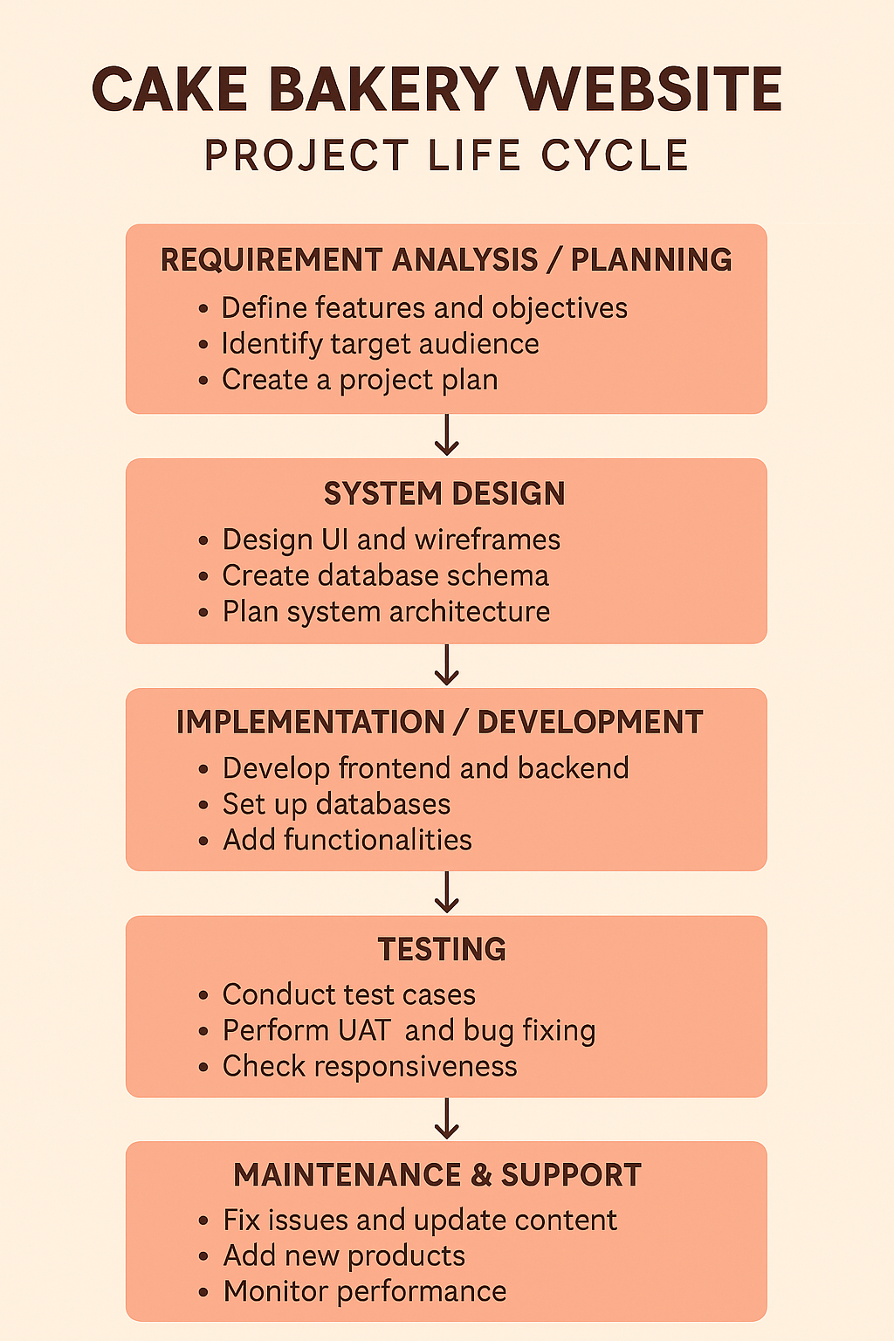
Project Life Cycle:

Slide 5
Languages used:
Frontend: React.js, HTML5, CSS3, JavaScript
Backend: Node.js, Express.js
Database: MongoDB
API: Custom REST API
Other Tools: VS Code

Slide 6
Modules:
User Module
Product Module (Cakes & Categories)
Favorites & Reviews Module
Cart & Checkout Module
Order Management Module
Payment Module

Slide 7
Module Description:
User Module: Handles user registration, login, and secure access with JWT.
Product Module: Add/Edit/Delete Cake Items (Admin),Categorize Cakes.
Favorites & Reviews Module: Allows users to bookmark cakes and add/edit reviews.
Order Management Module:
Provides Place Orders,View Past Orders.

Slide 8
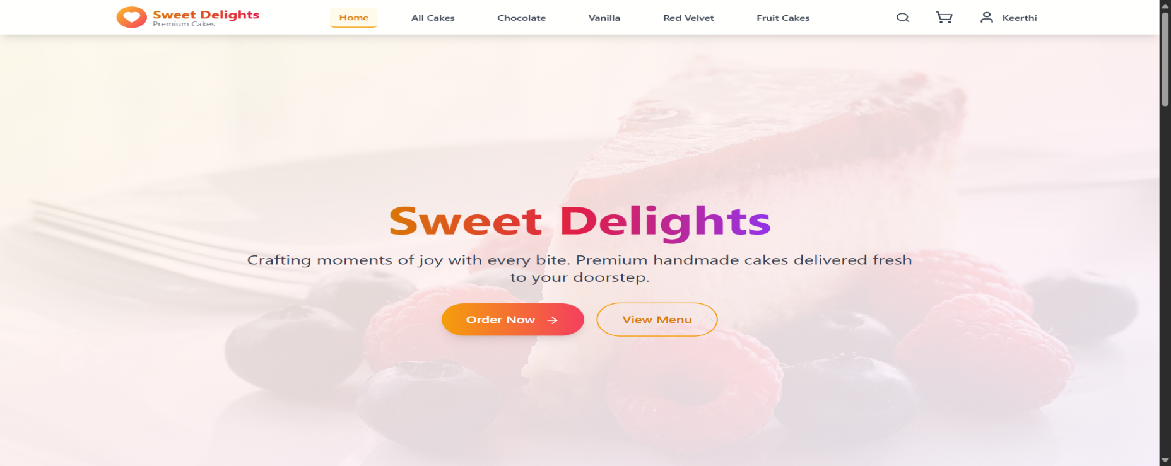
Screen Shots:

Slide 9
Application of the Project:
Online Cake Ordering and Payment
Product Display and Customization Requests
Order Tracking and Delivery Management
Customer Feedback and Business Promotion

Slide 10
References:
MongoDB – NoSQL database for product and order storage https://www.mongodb.com/docs
W3Schools – Web development tutorials https://www.w3schools.com
Express.js Documentation
MongoDB Manual

Slide 11
Conclusion:
The Cake bakery Website is a fully functional MERN stack-based platform.This project successfully implements a full-stack web application integrating user authentication, content management, and activity tracking. The React frontend provides a dynamic and responsive user interface, while the backend ensures secure and efficient data handling. Features like login/signup, profile management, and activity logging enhance the overall user experience. Content creation, editing, and deletion are streamlined through a robust and user-friendly interface.

Slide 12
Future Work:
Mobile app development
AI-based cake recommendations
Live order tracking
Multi-language support
Inventory management system
Customer loyalty program

Slide 13
Thank you ☺

